Slide 1
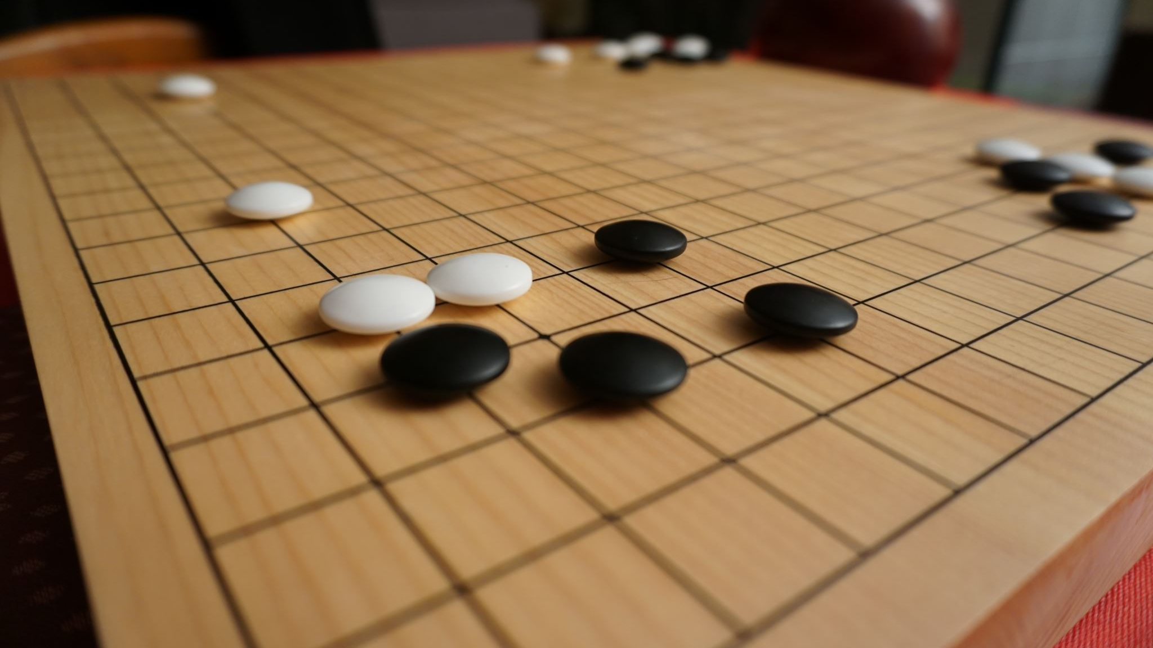
Sudoku using CSP
Group:14
By:
Muhammad Hassan: FA21-BCE-051 Muhammad Bilal Butt: FA20-BCE-039

Slide 2
Outline
Introduction
Literature Review
Proposed Solution
Results
Teamwork / Tasks Division
Timeline
Learning
Conclusion

Slide 3
Introduction
Brief introduction to the CEP :
The Sudoku using CSP (Constraint Satisfaction Problem) project aims to implement a Sudoku game with an underlying AI-based solver using the Constraint Satisfaction Problem paradigm..
Motivation and applications:
The motivation behind this project lies in exploring the application of AI, specifically CSP, and CSP are too friendly with Sudoku, Sudoku is a popular puzzle game ,and mostly people know about it .
Aims and objectives:
Implement Sudoku Game:
Develop a user-friendly Sudoku game interface using the Tkinter library in Python.
CSP-Based Solver:
Integrate a CSP solver to automatically solve the Sudoku puzzle.
User-Driven Interaction:
Enable users to check the correctness of their solutions using the implemented CSP solver.
Educational Value:
Serve as an educational tool to showcase the practical implementation of CSP in problem-solving.

Slide 4
Literature Review
Different Approaches: Brute Force:
Approach: Exhaustively try all possible combinations until a solution is found.
Strengths: Simple and easy to implement.
Weaknesses: Inefficient for large puzzles, especially those with many empty cells.
Backtracking:
Approach: Systematically , undoing choices that lead to dead-ends.
Strengths: More efficient than brute force
Weaknesses: Can still be slow for very complex puzzles.
Constraint Propagation:
Approach: Use constraints to eliminate possibilities iteratively, reducing the search space.
Strengths: More efficient than brute force or backtracking, especially for puzzles with unique solutions.
Weaknesses: Complexity increases for puzzles with many possibilities at each step.
Why we use CSP: CSP for Sudoku stem from its logical representation, efficiency in handling constraints, adaptability to varying complexities, and support for user interactions.

Slide 5
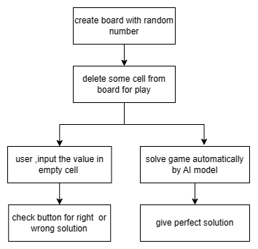
How The Project Work

Slide 6
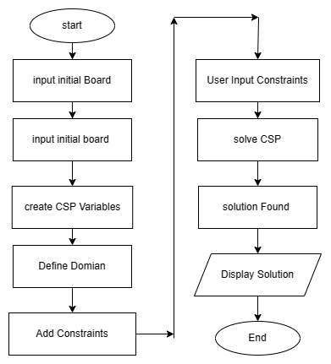
Flow Chart

Slide 7
Proposed Solution
Different Approaches:
Genetic , brute force, constranits propagation etc Proposed method:
Solve by CSP(constranit satisfaction problem) Basic Algorithm: given assignment(value) to a variable and check wheather it's violate the contranits or not if violate the constranits, then they use backtracking Adavntages : Logical Representation:
Benefit: CSP provides a natural and logical representation of the constraints in Sudoku. Variables, domains, and constraints can be directly mapped to the puzzle's structure, making the modeling process intuitive.
Declarative Problem Solving:
Benefit: CSP allows for a declarative problem-solving approach. The focus is on defining what the solution should look like (declarative), rather than explicitly prescribing how to reach the solution (procedural). This simplifies the problem-solving process.

Slide 8
Proposed Solution
Efficiency in Handling Constraints:
Benefit: CSP is designed to handle constraints efficiently. Sudoku puzzles have strict rules regarding the placement of numbers in rows, columns, and subgrids. CSP can enforce these constraints effectively, leading to optimized puzzle-solving.
Adaptability to Varying Puzzle Complexities:
Benefit: CSP techniques can adapt well to puzzles of varying complexities. Whether the puzzle is straightforward or highly intricate, the same CSP framework can be applied with adjustments to the constraints, allowing for a unified approach.
Support for User-Input Constraints:
Benefit: CSP naturally accommodates user-input constraints. As users fill in values, these become additional constraints in the CSP model. This user interaction is seamlessly integrated into the solving process.
Why other approaches not used: Computational complexity may be high, and convergence to a solution is not always guaranteed. Inefficient for large puzzles, especially those with many empty cells.
Complexity increases for puzzles with many possibilities at each step.
Can still be slow for very complex puzzles.

Slide 9
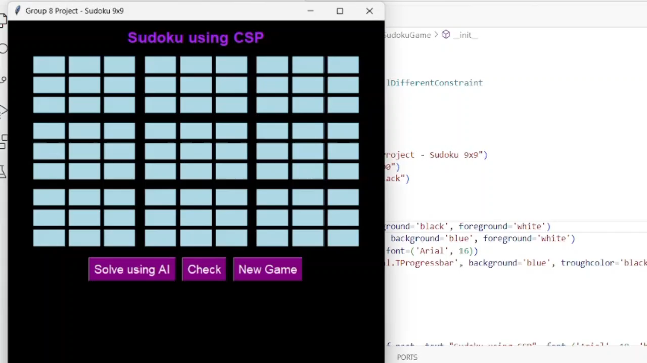
Results

Slide 10
Teamwork/Tasks Division Muhammad Bilal butt
Responsiblities: Search study about sudoku ,how it actually work,
basic idea on paper
constranit possiblities,
report
GUI layout
Contribution: develop Constranit possiblities making flowchart search on different method and whose is best layout in design of GUI
Challenges Overcome: contranits graph help in constranit possibleties

Slide 11

Teamwork/Tasks Division Muhammad Hassan
Responsiblities: Code and GUI implementation How CSP adjust in code with GUI
How CEP make user friendly
make presentation
Contribution: develop GUI
Linked the code and GUI to get goal
Make CEP as a AI solver as well as user solver
Challenges Overcome: Search about GUI how it linked with code,different video watched ,about sudoku

Slide 12
Timeline
Day 1:
Task division and search Different link
Day 2-3: (M.Hassan)
How Gui linked with code
Day 2-3: (M.Bilal butt)
Possible constranits and how we fullfill the constranit condition requirement
Day 4-5:(M.Hassan)
Searched about different liberaries that help in CEP code implementation
Day 4-5:(M.Bilal Butt)
How we make precise our problem
Day 6-7: (M.Hassan)
Implement code and make presenation
Day 7-8: (M.Bilal butt)
Make flow chart and report

Slide 13
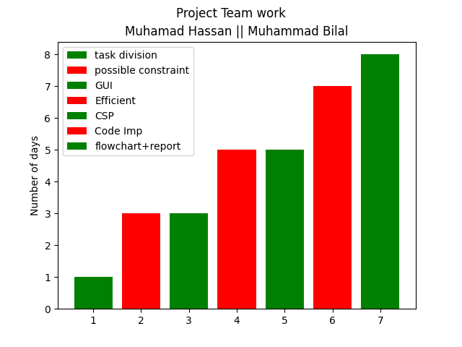
Timeline

Slide 14
Learning:
. Algorithmic Insight:
Exploration of genetic algorithms, brute force, and constraint propagation provided nuanced insights into algorithmic problem-solving.
Logical and Declarative Approach:
Emphasis on logical representation and declarative problem-solving simplified the overall approach to Sudoku.
Efficient Constraint Handling:
Demonstrated the importance of efficiency in constraint handling, showcasing CSP's optimization in enforcing Sudoku rules.
Adaptability to Complexity:
CSP's adaptability to puzzles of varying complexities highlighted a unified approach regardless of intricacies.
Practical AI Integration:
Practical application of AI concepts, particularly CSP, enhanced understanding and application of theoretical knowledge.
Algorithmic Decision-Making Skill:
Evaluation of different approaches honed algorithmic decision-making skills based on problem characteristics.
Iterative Learning Process:
Iterative solving of Sudoku puzzles emphasized continuous learning, analysis, and improvement in algorithmic strategies.

Slide 15
Conclusion
This CEP project not only provided a platform to delve into the complexities of Sudoku but also facilitated a deeper appreciation for the practical implementation of AI concepts. The fusion of theoretical understanding, algorithmic decision-making, and the hands-on experience with CSP positions this project as a valuable contribution to the exploration of AI methodologies in problem-solving. As the final piece of this academic endeavor, it marks a significant step towards a nuanced understanding of AI in action.

